Slide 1




DIBBs Brown Dog Conversions

Slide 2
Conversions - Outline
Overview of Problem
BrownDog Architecture
Overview of Code
Hands On

Slide 3
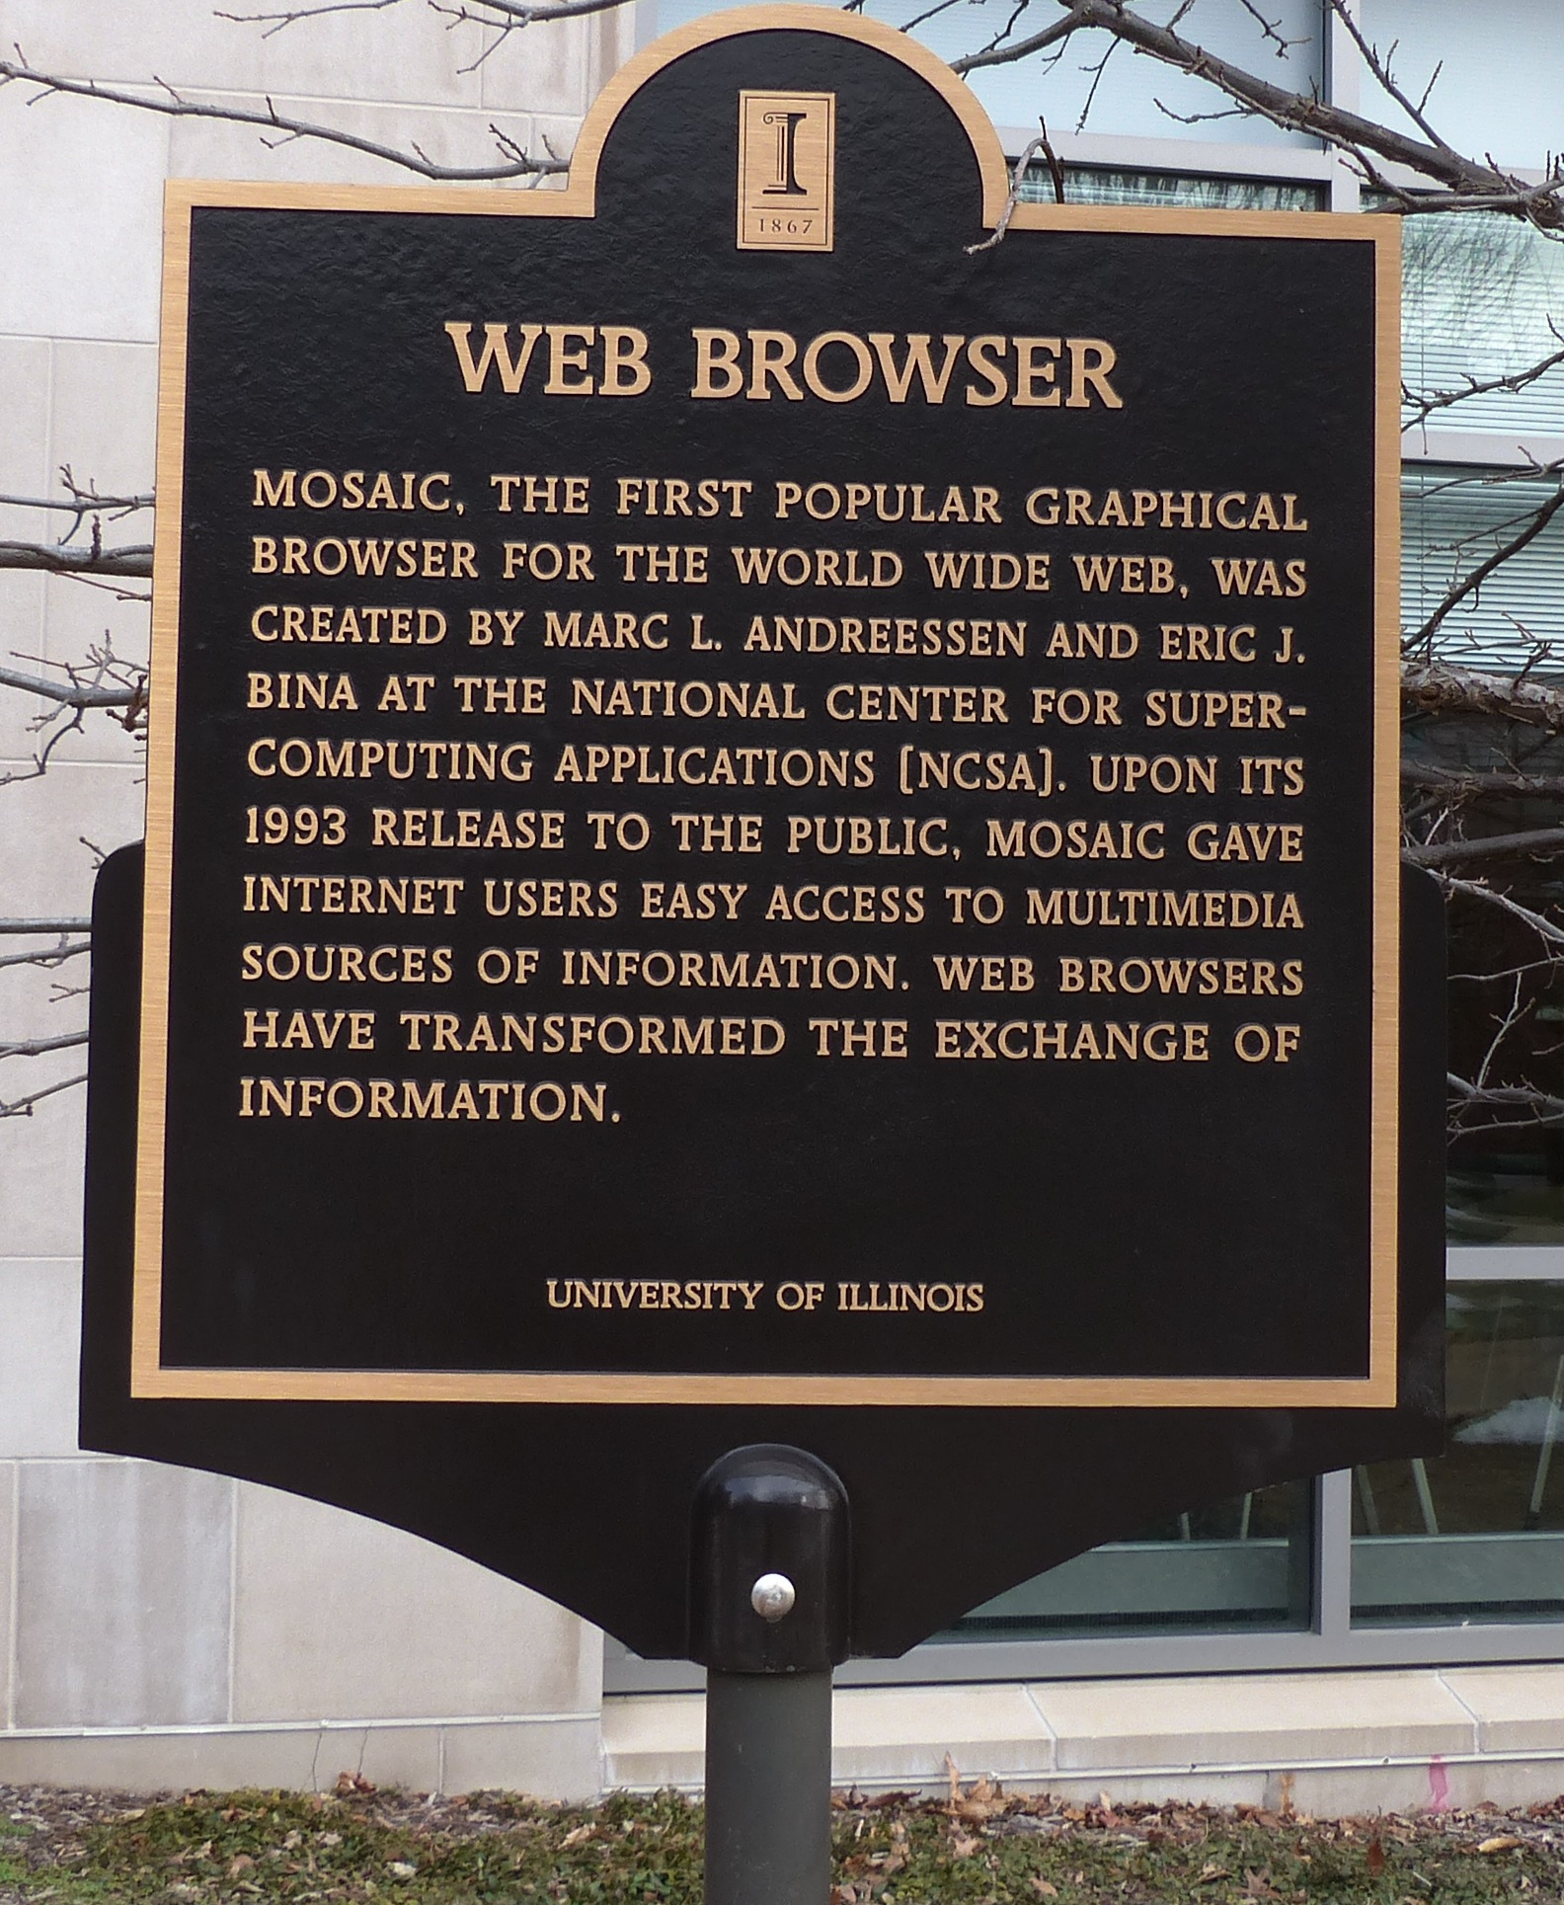
The Problem – Files You can’t Open
You have a folder with a bunch of files in various unopenable or not practical formats.
Use BrownDog to convert all files to PDF
.txt
.ps
.jpg
.odp

Slide 4

Brown Dog Architecture
Web Browser (BDFiddle)
Clients
(e.g. bdcli)
HTTP/HTTPS
RabbitMQ (Event Bus)
HTTP/HTTPS
Fence (API Gateway)
NGINX (Load balancer)
NGINX (Load balancer)
Polyglot
…
Polyglot
Clowder
Clowder
…
MongoDB
MongoDB (Data, Metadata)
Converter (Software Server)
Converter (Software Server)
Extractor
Extractor
…
…
Conversions
Extractions
Notes:
We show here the architecture of the Brown Dog services: i) The DTS is built on top of the Clowder framework which is a web-based content management system. Using the DTS REST API, a user can upload a file/dataset or url to a file to the DTS. This triggers specific extractors based on appropriate MIME types, for extraction of metadata, signatures or any derived product from the file’s content. Inside DTS, there is a distributed messaging bus, RabbitMQ, which reliably distribute and manage job execution by placing messages in a queue for each extractor, and removing them when job done. Extractors listens to the RabbitMQ for new messages for extraction. It saves all input files, dataset and outputs in MongoDB. Extractors can be written in any language as longs as it can communicate with RabbitMQ and Clowder REST interface via HTTP – Java, Python, Scala, C/C++. Extractors are deployed within distributed cloud environment.
Data Access Proxy, It is built on top of the Polyglot framework and provides REST API allowing users and applications to use its conversion capabilities. One of the key component is Software Server which hosts one or more applications. It uses light weight wrapper script to automate specific functionalities within the application and then provide access to it via a consistent REST API. Software Server listens a RabbitMQ bus for any conversion jobs and has a queue for each software it controls. DAP polyglot head node monitors the RabbitMQ bus and queries for all available Software Servers and the software’s input and output formats it supports. It constructs a Input/Output graph, finds the shortest conversion path between specific input and output format and allow SS to do the conversion.

Slide 5
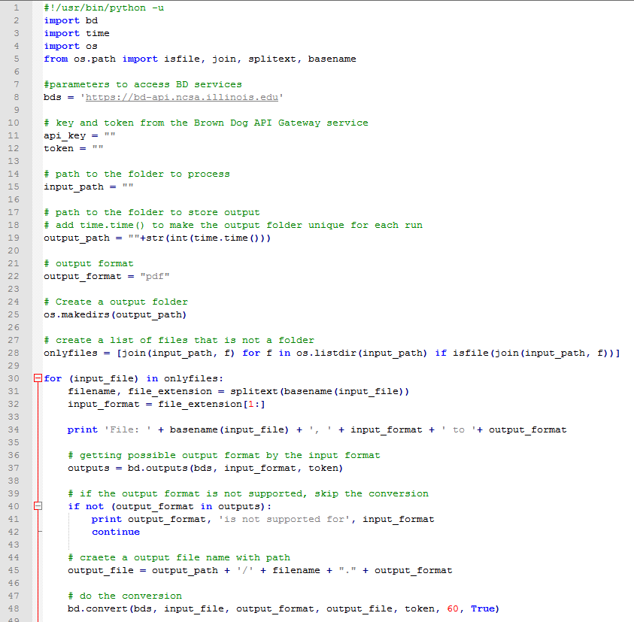
bd-conversion.py - Parameters
Importing modules
Brown Dog service API URL
Token for API authentication; obtain this from previous tutorial
The folder that contains files to convert
~/git/….
The folder that will contain output files
~/git/….
Target format
Create output folder

Slide 6
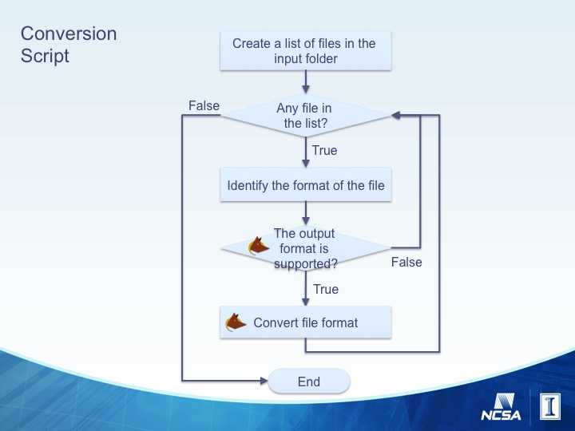
bd-conversion.py - Main
Create a list of files (not folders)
Split the file extension
from the full path
Print out a message
File: js.jpg, jpg to pdf
Call BrownDog API to find
supported output format
If the output format is not
supported, then Skip
Create a full path of
output file
Call Brown Dog API to convert the file
bd.convert(BD_API_URL, input_file, output_format, output_file, token, wait_time_in_sec, verbose_mode)
Looping through each file

Slide 7
Brown Dog Keys and Tokens
For this example, you will need token to access the Brown Dog service.
If running on local installation of Brown Dog service, make sure, all opencv and OCR extractors are running along with Clowder, Rabbitmq, Mongodb, fence, and redis server.
Obtain a token if you have not obtained one before

Slide 8
Hands On 1 – Start Editing
cd /home/ubuntu/git/bd-tutorial-problems/04-Conversions
nano bd-conversion.py

Slide 9
Hands On 2 - Parameters
token=“e474f26b-3102-41e9-90f3-fd38cee9faf1”
input_path=“/home/ubuntu/git/samplefiles/conversion/”
ouput_path = “/home/ubuntu/git/bd-tutorial-problems/04-Conversions/“+str(int(time.time()))

Slide 10
Hands On 3 – Main Loop
Add three lines of code that searches the outputs list for the desired output and skips the file if it cannot be converted to the desired output format.
Hint: use ‘if not’ and ‘continue’, and print to terminal if conversion not possible.
outputs = bd.outputs(bds, input_format, token)
if not (output_format in outputs):
print output_format, 'is not supported for', input_format
continue
Add one line of code to create output file path using basename from input file as basename for output file.
bd.convert(bds, input_file, output_format, output_file, token, 60, True)
Add one line of code to run the conversion.
Hint: use bd.convert(args)
output_file = output_path + '/' + filename + "." + output_format
Add one line of code that gets all available outputs for the input file type.
Hint: use bd.outputs(args)

Slide 11
$ python bd-conversion.py
File: ncsa.jpg, jpg to pdf
/home/ubuntu/git/bd-tutorial-problems/04-Conversions/1468803200/ncsa.pdf
File: browndog.txt, txt to pdf
/home/ubuntu/git/bd-tutorial-problems/04-Conversions/1468803200/browndog.pdf
File: comp_analysis2000.ps, ps to pdf
/home/ubuntu/git/bd-tutorial-problems/04-Conversions/1468803200/comp_analysis2000.pdf
File: Intro_LaTeX_PG.odp, odp to pdf
/home/ubuntu/git/bd-tutorial-problems/04-Conversions/1468803200/Intro_LaTeX_PG.pdf

Slide 12
Thanks!

Slide 13
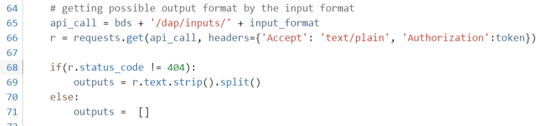
Without bd.py: bd-conversion-no-bd.py
How bd.outputs method works
The bd-conversion-no-bd.py shows how you could use Brown Dog API without bd.py
Create API http URL:
https://bd-api.ncsa.Illinois.edu/dap/inputs/jpg
HTTP GET call with your token
The response is not 404 error:
create an array [“pdf”, “png”, …]
If the response is 404 error:
create an empty array

Slide 14
bd.py
Bd.py is a python module that the API users can call Brown Dog API service readily
get_key(url)
return key with given username and password
get_token(url, key)
return token with given key
outputs(url, input_format, token)
return a list of supported output formats with give input_format
convert(url, input_file, output_format, output_path, token, wait, verbose_mode)
Convert a input file to output_format

Slide 15
Hands-on Exercise
Run an example script (more complete application with command line interface)
The script goes over each file, shows possible formats to be converted, lets you to choose the format
You need to use Brown Dog username and password you created before.
~/git/bd-tutorial-problems/04-Conversions/conversion_interactive_tutorial.py

Slide 16
Hands-on Exercise
Finish the bd-conversion.py
Editor: vi or nano
Script: ~/git/bd-tutorial-problems/04-Conversions/bd-conversion.py
By using the hardcopy of the code to finish the bd-conversion.py
Input files folder
/home/ubuntu/git/samplefiles/conversion/input
Output folder
/home/ubuntu/git/samplefiles/conversion/output
Run the code
> python bd-conversion.py
Check the converted file in output folder by downloading files via SFTP client (for windows: winscp)
Try to change target format from PDF to PNG and run the code

